Slide 1


Spectral Attention-Enhanced HybridSN with
Multi-Objective Loss for Underwater Habitat
Segmentation from Hyperspectral Imagery
Arfi Raushani Fikra, Riyanarto Sarno, Laurensia Simanihuruk, Dalila Anwar Dini Rasyidah, Alya Kamilah, Kelly Rossa Sungkono, Fadlilatul Taufany, Arif Abdullah Sagran
26 February 2026
5025211084@student.its.ac.id

Slide 2
Outlines
Background (Motivations, Problems, Research Objectives, Related Works, Gaps)
Methodology (Dataset Overview, Preprocessing Pipeline, Baseline Architecture, Proposed Novelties, Training Strategy)
Results (Ablation Study Results, Spectral Attention Analysis, Failure Analysis, Qualitative Results, Key Findings, Contributions, Limitations, Future Works)

Slide 3


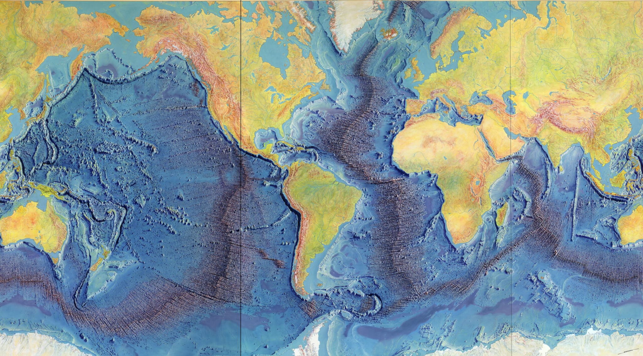

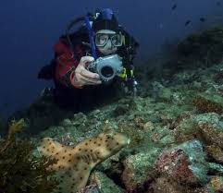
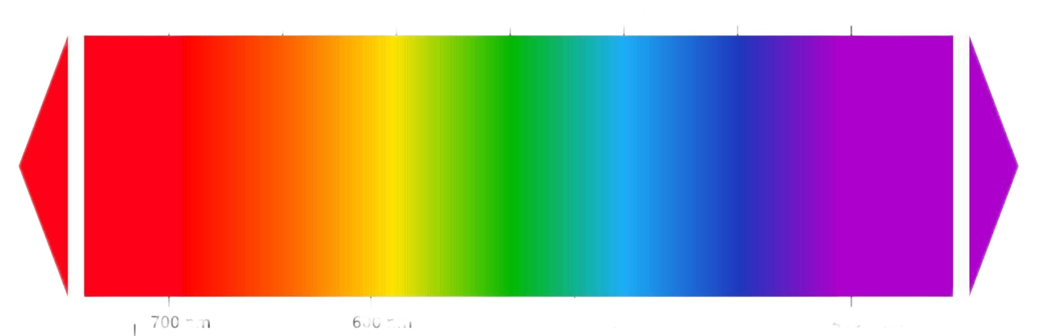
Motivation & Problem
The Challenges
< 10% ocean floors mapped
Manual surveys are expensive and slow
Insufficient spectral information when using RGB Image
Why it matters?
Climate change monitoring
Marine biodiversity conservation
Sustainable resource management
Technical Problem
Severe class imbalance (74% background)
Similar spectral signatures
Water absorption dominates IR bands
2

Slide 4


Research Objectives
Enhance HybridSN with Spectral Self-Attention
→ Adaptively emphasize underwater-relevant wavelengths
1
Investigate Multi-Objective Loss Combinations
→ Address extreme class imbalance
2
Validate on Real Norwegian Coastal Dataset
→ 7 habitat classes, 300 spectral bands
3
3

Slide 5
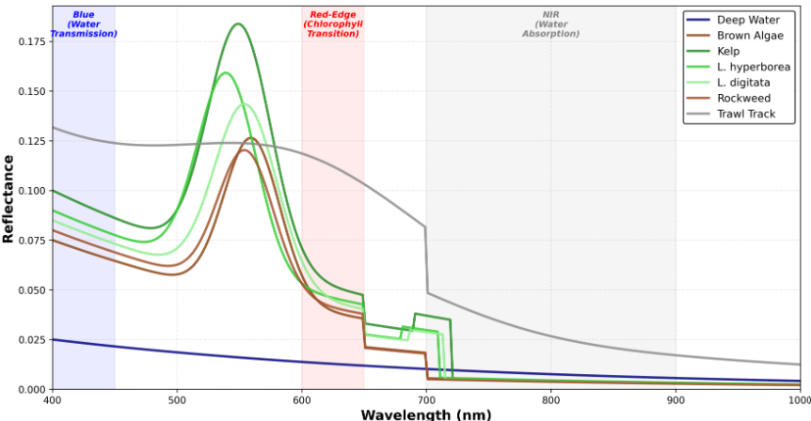
Hyperspectral Imaging for Underwater
Dataset for this study :
Sensor : Resonon Pika-L
Bands: 300 (400-1000 nm)
GSD: 3.5 cm
Platform: UAV-mounted
Location: Norwegian coast
RGB Camera :
3 Bands (Red, Green, Blue)
→ Limited discrimination
Hyperspectral :
300 Bands [400nm...500nm...1000nm]
→ Rich spectral features
4

Slide 6
Related Works & Gaps
Classical ML (2010-2015)
Deep Learning
(2016-2023)
Our Work
(2025)
SVM, Random Forest
2D CNN
HybridSN + Spectral Attention
Fast
No spatial context
Spatial features
Ignores spectral
Adaptive wavelength weighting
Negative results on loss combinatons
3D CNN
Spectral-spatial
High computation
Easy overfitting
GAP
Existing methods : Treat all wavelengths equally
Underwater Specific : Need to suppress water-absorbed bands
Extreme Imbalance : Standard losses fail
Handcrafted features
Domain expertise required
Interpretable
HybridSN
Efficient 3D+2D
Uniform band weight
Terrestrial focus
5

Slide 7
Dataset Overview
MASSIMAL Dataset (Norwegian Coastal Sites)
Maholmen, Smola Island, Norway
17 Hyperspectral images
300 Bands
3.5 cm ground sampling distance
7 Habitat classes
Deep water (background) 74%
Brown Algae
Kelp
Laminaria hyperborea
Laminaria digitata ← Rare class (1 image)
Rockweed ← Rare class (1 image)
Trawl Track
Split strategy
Train: 8 images → 2,805 tiles (96×96)
Val: 6 images → 3,490 tiles
Test: 2 images → 2,338 tiles
1 image split vertically (contains two rare classes) and distributed for each train-val-test split
6

Slide 8
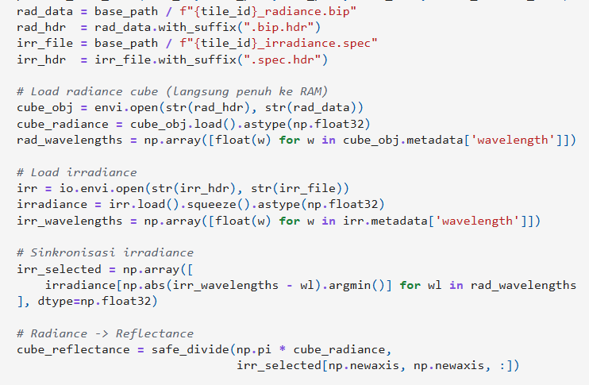
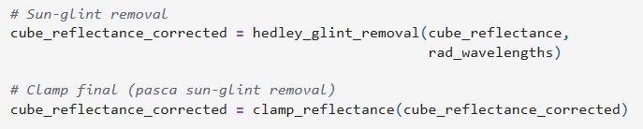
Preprocessing Pipeline
STEP 1 : Convert radiance to reflectance
Input : 4 files per image
radiance.bip
radiance.bip.hdr
irradiance.spec
irradiance.spec.hdr
Reflectance = (π × Radiance) / Irradiance
STEP 2 : Sun glint removal
Uses NIR bands (800-900 nm) to estimate glint
STEP 3 : Normalization
Min-Max scaling to [0, 1]
STEP 4 : Tiling, Splitting, & Augmentation
96×96 tiles,
augmentation : flips + 90°/180°/270° rotations
Output : Preprocessed tiles for training
7

Slide 9
Baseline Architecture (HybridSN)
Input
B, 96x96 tiles, 300 bands
Focus on spatial features
Conv3D_1 (7x3x3,
16 filters)
Conv2D_1 (3x3,
256 filters)
Spectral Pooling
Proposed : Spectral Attention
3D Convolution Block
Reshape
2D Convolution Block
Conv2D_2 (3x3,
128 filters)
Conv3D_2 (5x3x3,
32 filters)
Conv3D_3 (3x3x3,
64 filters)
Conv2D_3 (3x3,
64 filters)
300 bands → 8 bands
[B, 512, H, W]
Flatten spectral dimension
Classifier (Conv2D)
Extract spectral-spatial features
Reduce spectral dimension
7 class probabilities
Output
Further compression
8

Slide 10
Input (x)
Proposed Enhancement 1 : Spectral Attention
Global Average Pooling
Global Maximum Pooling
Learn which spectral combinations are discriminative
Suppress water-absorbed bands (IR region >700nm)
Emphasize informative regions (blue 400-450nm, red-edge 600-650nm)
Physically interpretable attention weights
Fully Connected 1 (512 → 32)
ReLU
Fully Connected 2 (32 → 512)
Sigmoid (avg_weight + max_weight)
Attention weights
Output
Output = x * attention weight
9

Slide 11
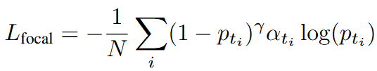

Proposed Enhancement 2 : Multi-Objective Loss
Theoretical Motivation
Catastrophic Failure
Focal Loss (γ=5.0)
What happened :
Baseline (CE only) : mIoU = 11.84%
Spectral Attention : mIoU = 12.08% ✓ (+2.0%)
Focal Loss (γ=5.0) : mIoU = 3.21% ✗ (-73.4%)
Dice Loss : mIoU = 2.79% ✗ (-76.9%)
Purpose :
Down-weight easy examples
Focus on hard negatives
Address class imbalance
Combined :
L_{total} = L_{focal} + L_{dice}
Why it Failed :
γ=5.0 over-amplifies hard examples causing gradient instability
Focal (sample-wise) conflicts with Dice (region-wise)
Optimizer cannot navigate chaotic loss landscape
Attention learning disrupted
Dice Loss
Purpose :
Region-level overlap
Spatial coherence
IoU-like optimization
10

Slide 12
Training Strategy
Optimizer & Hyperparameters
Optimizer : AdamW
Learning rate : 1×10⁻⁴
Weight decay : 1×10⁻⁵
Effective batch size : 4 (via gradient accumulation)
Gradient clipping : max norm 0.5
Class Imbalance Mitigation
Strategy 1 : Power-law class weighting
α_{c} = (1/(freq_{c} + ϵ))^{0.8}
Background weight = 0
Strategy 2 : Adaptive oversampling
Extremely rare (<50 tiles): 15× oversample
Rare (50-200 tiles): 10× oversample
Medium (200-1000): undersample to 500-600
Learning Rate Schedule
Phase 1 : Warmup (5 epochs)
Linear increase : 1×10⁻⁵ → 1×10⁻⁴
Prevents early instability
Phase 2 : ReduceLROnPlateau
Monitor : Validation mIoU
Patience : 5 epochs
Factor : 0.5 (halve LR)
Min LR : 1×10⁻⁷
Data Augmentation
Horizontal flip
Vertical flip
Rotations: 90°, 180°, 270°
Early Stopping
Patience : 15 epochs (no improvement in val mIoU
Hardware
Nvidia RTX 4080 Super (16GB)
11

Slide 13
Ablation Study Results
Configuration | Pixel Accuracy | mIoU | Spectral Attention | Focal Loss | Dice Loss
Baseline (CE) | 56.68% | 11.84% | - | - | -
Spectral Attention (withSA) | 58.02% (+1.34%) | 12.08% (+2.0%) | ✓ | - | -
Focal Loss (SAFocal) | 17.64% (-69.6%) | 3.21% (-73.4%) | ✓ | ✓ | -
Dice Loss (Full) | 15.05% (-74.0%) | 2.79% (-76.9%) | ✓ | ✓ | ✓
Key Findings :
Spectral Attention : +2.0% mIoU improvement
Stable channel selection (weights converged)
Focal+Dice : Catastrophic optimization failure
Model collapsed to predicting only dominant class
12

Slide 14
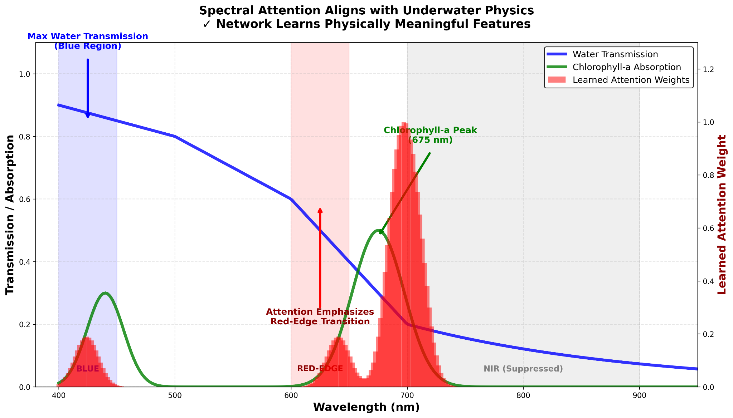
Spectral Attention Analysis
Top 9 Channels (weight = 1.0) : 152, 144, 153, 154, 147, 146, 120, 12, 448
→ Blue (400-450nm) + Red-Edge (600-650nm) Regions
Attention aligns with underwater optical physics
Emphasizes discriminative wavelength regions
Network learns physically meaningful features!
13

Slide 15
Failure Analysis
Gradient Conflict
Focal loss :
Amplified hard examples exponentially
Combined with α_{c} = (1/(freq_{c} + ϵ))^{0.8} caused extremely unstable updates
Dice loss :
Optimized global region overlap
Normalized across all pixels
Conflict : Exponential sample-wise (Focal) met smooth region-wise (Dice) resulting chaotic loss landscape
Class Collapse
Baseline: Distributes predictions across classes
withSA: Improved diagonal, some classes detected
SAFocal: Collapses to Class 3 only
Full: Complete collapse to Class 2
Lessons Learned :
γ=5.0 too extreme for 74% imbalance
Power-smoothed weights (freq^-0.8) amplify instability
Multi-objective loss needs careful gradient balancing
Simpler alternatives (class-balanced CE) may be better
Attention Disruption
withSA (CE only) : Stable, consistent patterns
SAFocal : Erratic, random noise pattern
14

Slide 16
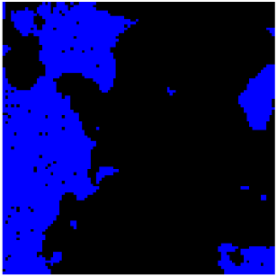

Qualitative Results
Underwater Scene
Segmentation with spatial structure
Key Observations :
Successfully captures spatial habitat structure
Delineates distinct ecological regions
Preserves boundary continuity
Demonstrates spectral-spatial feature learning
Note :
Despite class detection limitations (74% background imbalance), the model learns meaningful spatial patterns from hyperspectral features.
15

Slide 17
Key Findings & Contributions
Spectral Attention Enhancement
+2.0% mIoU improvement (11.84% → 12.08%)
Physically interpretable (aligns with underwater optics)
Stable convergence across runs
Underwater HSI Benchmark
First application of HybridSN to underwater segmentation
Dealing with 7 classes with severe imbalance (74% background)
Real-world Norwegian coastal dataset (300 bands)
Negative Result on Multi-Objective Loss
Demonstrates fundamental incompatibility :
Focal (γ=5.0) + Dice → 73-77% mIoU drop
Gradient conflict causes optimization collapse
Disrupts attention learning
Provides guidance for community :
Avoid extreme focusing parameters with extreme imbalance
Test simpler alternatives first
Scientific Value :
Transparent reporting of negative results
Physically grounded methodology
Actionable insights for imbalanced HSI segmentation
16

Slide 18
Limitations & Future Work
Limitations
Future Directions
🔴 Dataset
Single site (Norwegian coast only)
Limited size (17 images)
Two rare classes in single image
🔵 Cross-Site Validation
Test on different geographic locations
Different sensor types (cross-sensor)
Seasonal variations
🔵 Practical Applications
Real-time monitoring systems
Integration with bathymetry data
Decision support for conservation
🔴 Architecture
96×96 tiles provide limited spatial context
Tile-based processing → boundary artifacts
Memory constraints (16GB GPU)
🔵 Architecture Improvements
Multi-scale processing (64/96/128 tiles)
Hierarchical attention (band + spatial)
Transformer-based encoder
Memory-efficient training techniques
🔴 Performance
Absolute mIoU still low (12.08%)
Rare class detection incomplete
Multi-objective loss failed
🔵 Loss Function Research
Class-balanced Cross-Entropy
Lovász-Softmax loss
Sequential training strategies
Gradient balancing mechanisms
17

Slide 19
Acknowledgements
This research was supported by :
🏛️ Indonesian Endowment Fund for Education (LPDP) Ministry of Higher Education, Science and Technology Contract No. 4299/B3/DT.03.08/2025
🏛️ HETI ADB ITS - Penelitian Post-Doctoral
🏛️ SINERGI Hilirisasi Inovasi Komersial Program
🏛️ Ethereum Foundation Academic Grants Round 2025
📊 Dataset: MASSIMAL (Skjelvareid et al., 2025) NIRD Research Data Archive
Thank You For Your Attention, any questions?
[Contact information]
📧 5025211084@student.its.ac.id
🏛️ Institut Teknologi Sepuluh Nopember, Indonesia
18

